Slide 1
Sprint Review – Team A

Slide 2
Problem Significance
Task:
Estimate the circumference and area of a circle without using Pi
Goals:
Generate working code that accomplishes the defined task
Improve understanding of numerical methods
Familiarize ourselves with agile principles
Improve software development skills using Github

Slide 3
Algorithm Functions
get_circle_inputs(): user enters values—if they are incorrect, an error message pops up and they repeat entry
estimate_circ(): circle circumference is approximated to be compared with actual circumference
estimate_area(): circle area is approximated to be compared with actual area

Slide 4
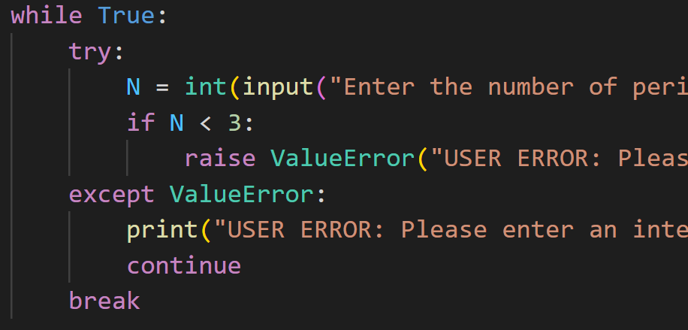
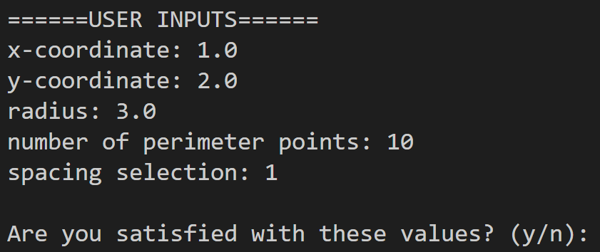
User Inputs
Try-except statements were used to catch user errors and make the user try again if the type of input is incorrect
After entering their inputs, the values are printed, and the user has the option to try again

Slide 5

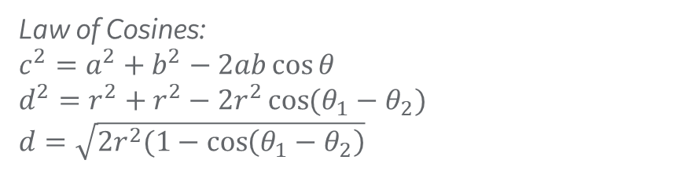


Numerical Methods
$θ$= $θ$₂
d
r
$θ$= $θ$₁
$θ$=0
Law of Cosines:
$c^{2}=a^{2}+b^{2}−2ab\cos{θ}$
$d^{2}=r^{2}+r^{2}−2r^{2}\cos{(θ_{1}−θ_{2})}$
$d=\sqrt{2r^{2}(1−\cos\left(θ_{1}−θ_{2}\right)}$
Circumference Estimation
Area Estimation

Slide 6


Function timers
Use of timer Python library to determine run time of each function
Example of timer encapsulating circumference function
tic_circ = time.perf_counter()
estimate_circ(r,n,choice)
toc_circ = time.perf_counter()
t_calc = (toc_circ - tic_circ) * 10 ** 6
print(f "Circumference approximated in {t_calc:0.4f} microseconds")
Timer started
Function call to circumference estimation
Timer ended
Timer Start – Finish (in microseconds)
Print statement
Same code used to encapsulate area estimation function

Slide 7
Unit Tests
Unit tests for the functions called to estimate circumference and area
Because it’s an estimate there are two ways to test the function: see if the estimate is “close” to the actual answer, or see if the algorithm used is being called properly -> went with 2nd by hand-calculating the estimate, then asserting with the code

Slide 8
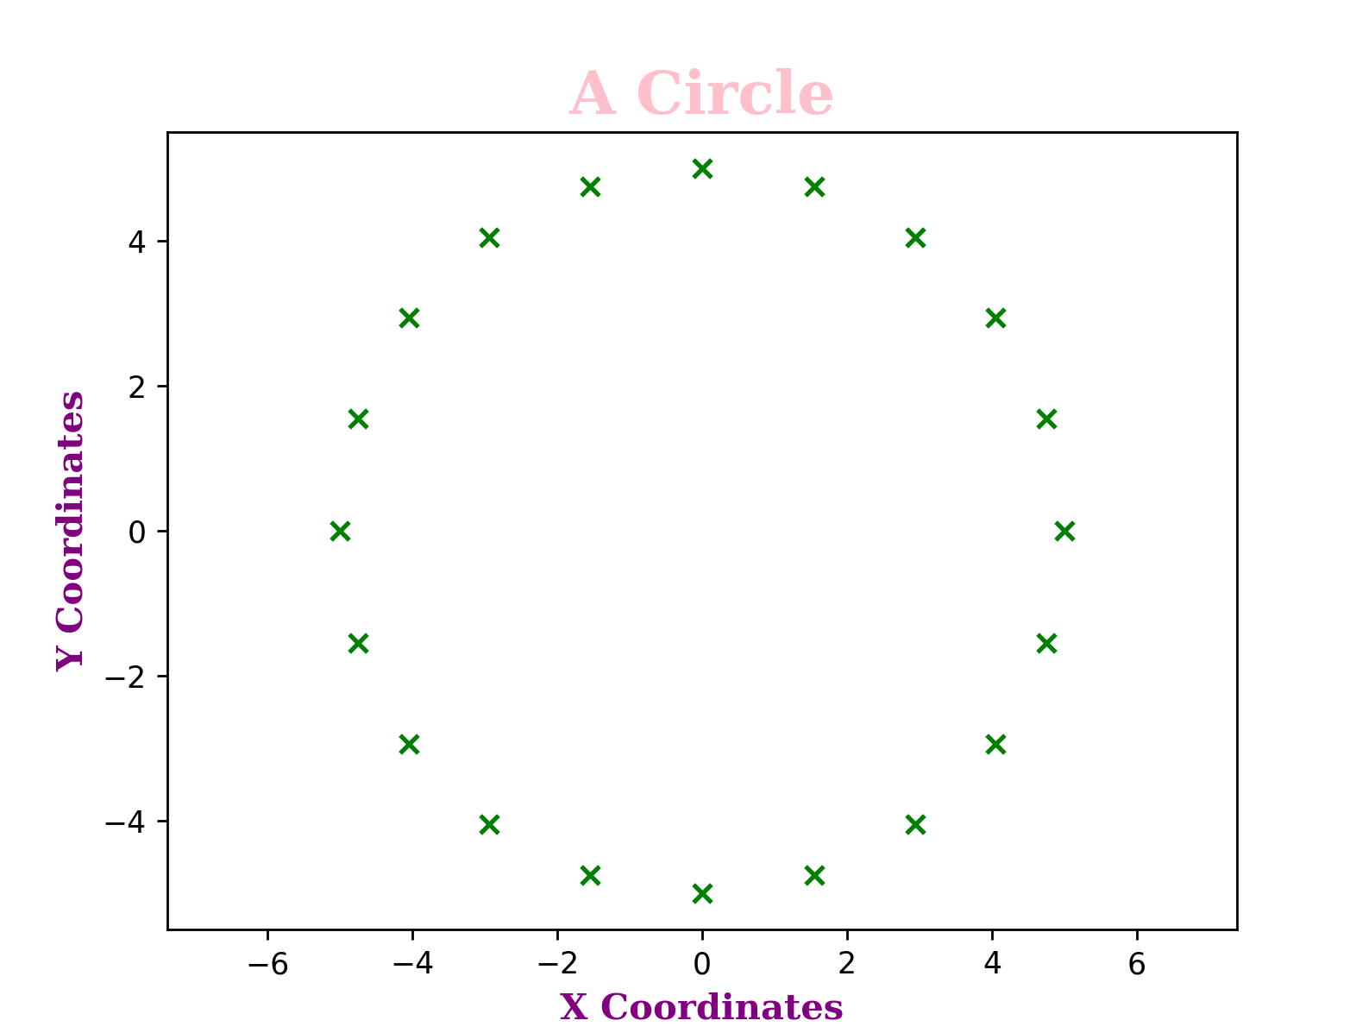
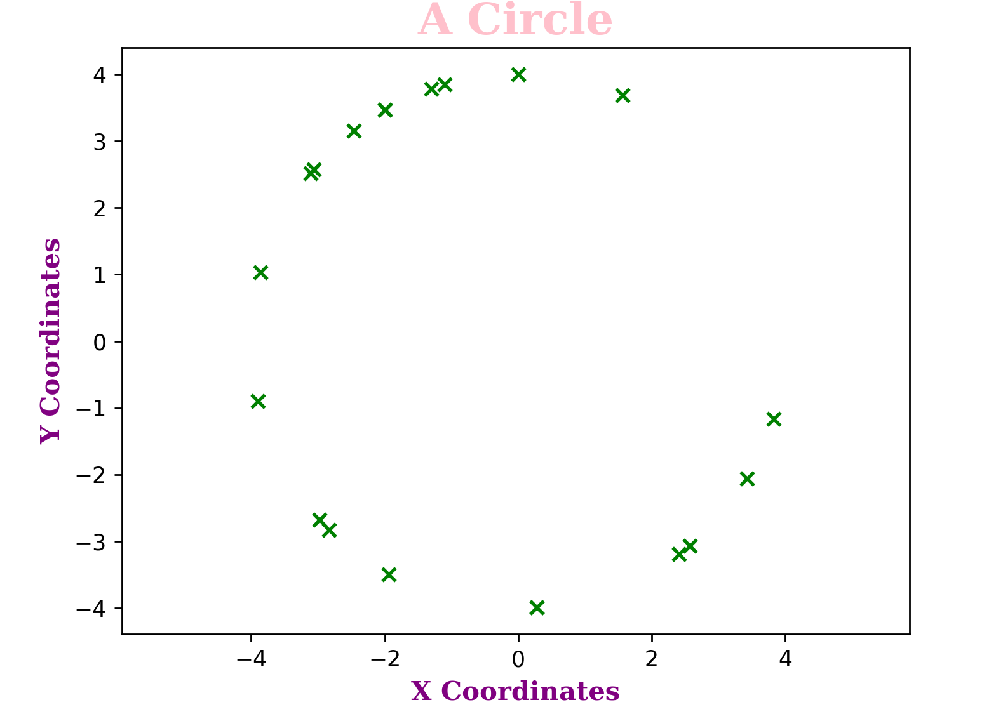
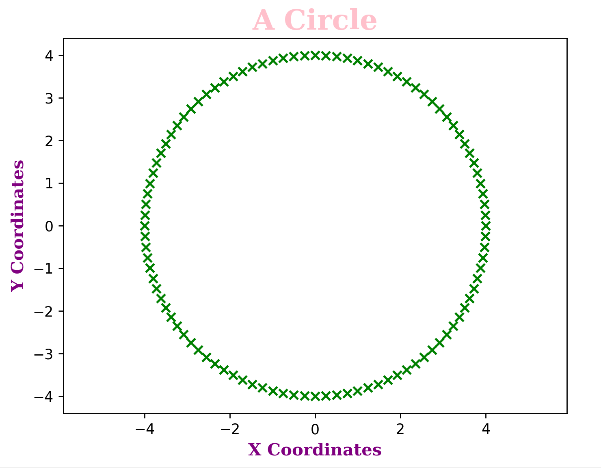
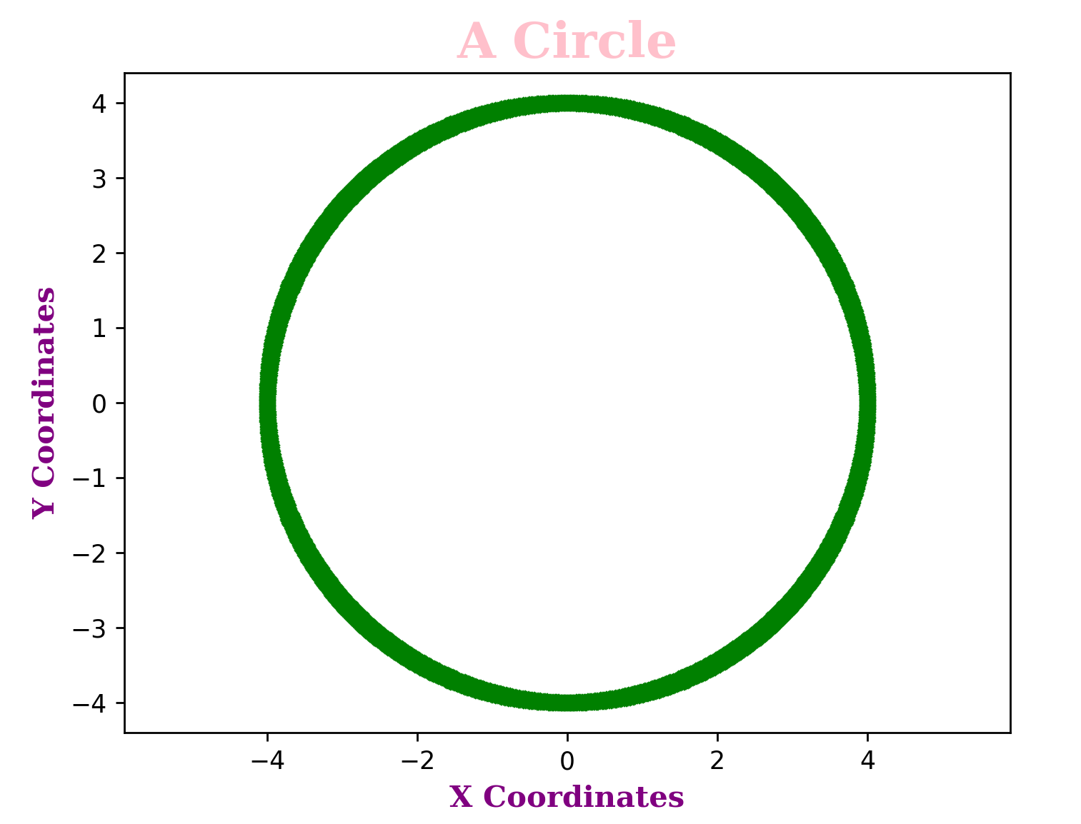
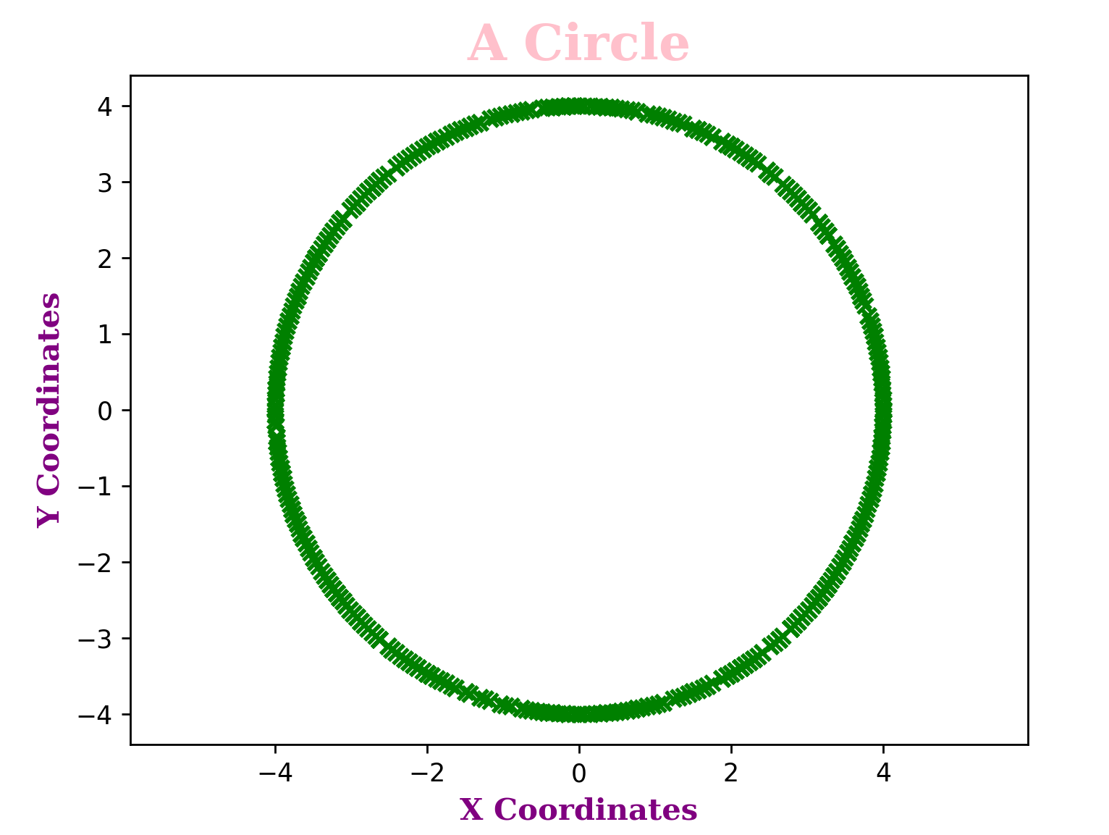
Sample plots from function output
N = 20 points
Eq. spacing
N = 20 points
Random spacing
N = 100 points
Eq. spacing
N = 1000 points
Eq. spacing
N = 10000 points
Random spacing

Slide 9
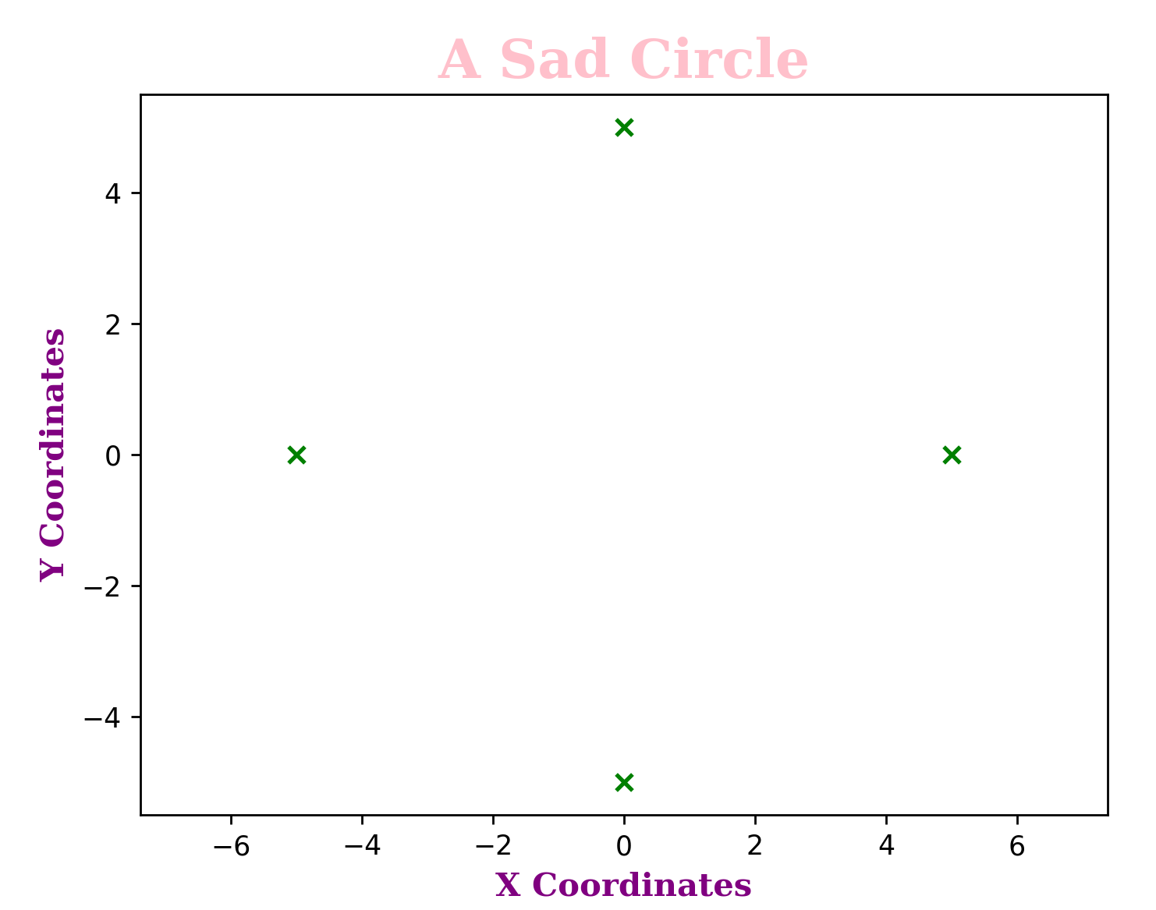
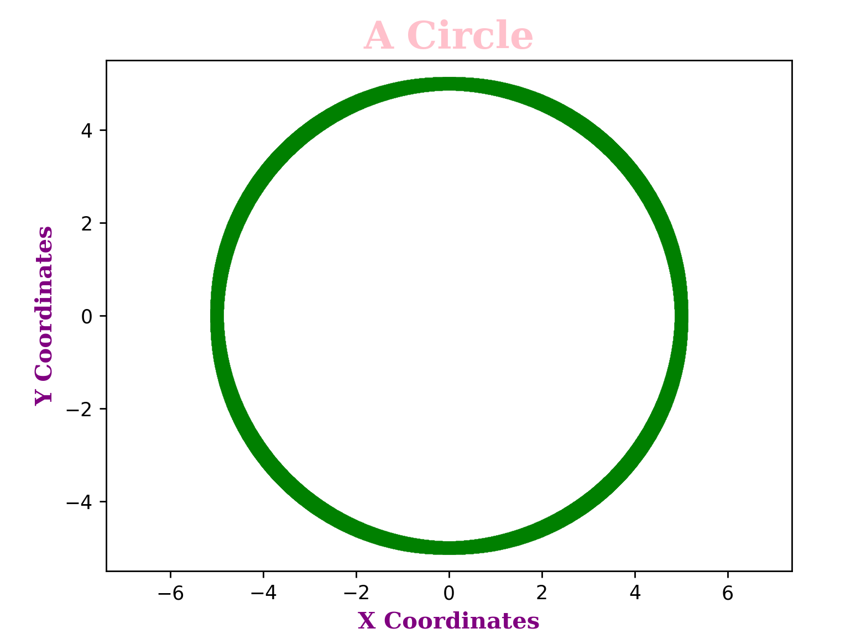
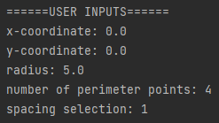
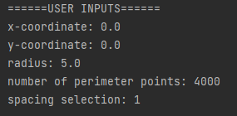
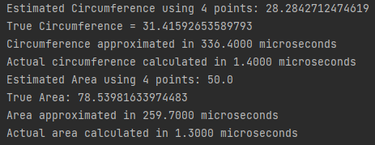
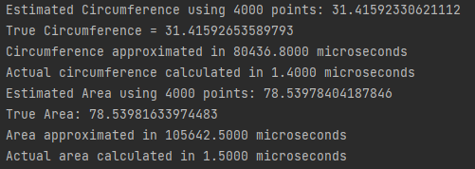
Input Parameter Impact on Results

Slide 10


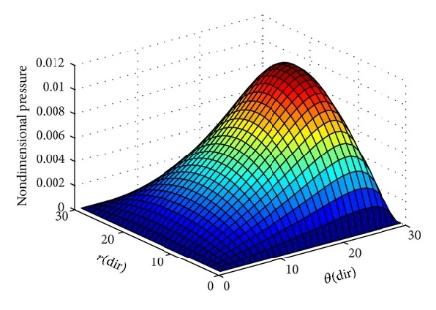
Impact of Numerical Methods at GE Research
Numerical methods can support a variety of applications such as:
Data Processing
Position, velocity, acceleration data (numerical integration)
Modeling and Characterization
Solving differential equations
Navier Stokes, Reynolds Eqn. (etc.)
Finite element analysis
Newton Raphson schemes
Forecasting and Projections
Lifing of mechanical components
https://www.google.com/url?sa=i&url=https%3A%2F%2Fwww.hindawi.com%2Fjournals%2Fisrn%2F2014%2F157615%2F&psig=AOvVaw2aNwglBezJ0NB5fqZKnwo2&ust=1670371193816000&source=images&cd=vfe&ved=0CAwQjRxqFwoTCMD1-uDX4_sCFQAAAAAdAAAAABAD
Most teams at GRC are using some form of numerical methods!
Above are just a few examples…

